Slide 1
KHARMA: the Code
Or, How to Hit σ of a Billion Without Really Trying
Ben Prather
GRMHD Tutorial Day 4, IAA, 11/27/2025

Slide 2
KHARMA: Requirements
Performance
Adaptability
  More & Longer simulations
    Expanded parameter studies
    Better variability measures
  Therefore we need:
    Accelerator support
    Mesh refinement
  More complex simulations
    Viscosity
    Radiative effects
  Maintain usability
    Accessible for modification
    Robust and reliable
  Therefore we need:
    Clarity
    Modularity

Slide 3
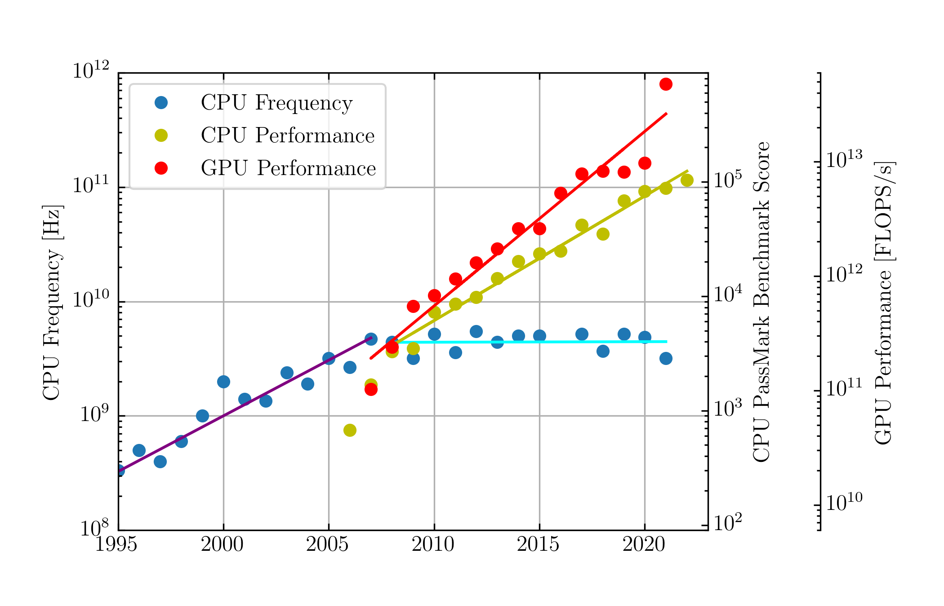
Portability → Longevity

Slide 4
HARM
Conservative finite-volume scheme
Local Lax-Friedrichs fluxes
Often uses high-order spatial reconstruction (WENO5)
Flux-CT (Tóth 2000) preserves B divergence
Uses Noble et al. 2006 “1DW” scheme to recover primitives
  GR additions are computationally expensive
Notes:
More advanced solvers trade stability and computation time
* Harten Lax VanLeer Einfeldt trades some stability in practice
* Better wave speed solutions trade computation time at best, many frame transformations at worst
* HLLC/D Riemann solvers trade further time & stability (they can give imaginary fluxes), and require frame transformations
There are many ways of defining B and keeping divB = 0, I plan to investigate a few.
WENO is not TVD, preserving maxima

Slide 5
KHARMA
AMR and Stability Improvements
Usually Local Lax-Friedrichs fluxes, optional HLLE
WENO5 or adaptive versions
Face-centered B; CT (Gardiner & Stone ‘05) preserves B divergence
First-order corrections for fluxes (FOFC)
Kastaun (2020) primitive variable inversion with stability improvements
  Momentum-preserving floors
Notes:
More advanced solvers trade stability and computation time
* Harten Lax VanLeer Einfeldt trades some stability in practice
* Better wave speed solutions trade computation time at best, many frame transformations at worst
* HLLC/D Riemann solvers trade further time & stability (they can give imaginary fluxes), and require frame transformations
There are many ways of defining B and keeping divB = 0, I plan to investigate a few.
WENO is not TVD, preserving maxima

Slide 6
KHARMA Features
Open-source development: issues, new features/in-progress code are public
  https://github.com/AFD-Illinois/kharma
Many algorithm options for different situations – advanced stability options for difficult spinning, tilted, or non-Kerr simulations
Easy to use, with all run-time options and convenient simulation resizing and other features
Easy extension through “packages,” most additional physics does not require touching core code
Good documentation, helpful devs!

Slide 7
KHARMA
Driver and problem specifics
Extended GRMHD
B Field Transports
Electron temperature
GR(M)HD
Floors
GRFFE
(WIP)
Primitive Recovery
Implicit solver
Fluxes: reconstruction & Riemann solve
Core
Package utils
Common Types
Reductions
Boundaries
Coordinates
Parthenon: AMR, I/O, Time integration
Kokkos: Performance-portability
MPI
HDF5
Acceleration: OpenMP, CUDA, HIP, SYCL…

Slide 8
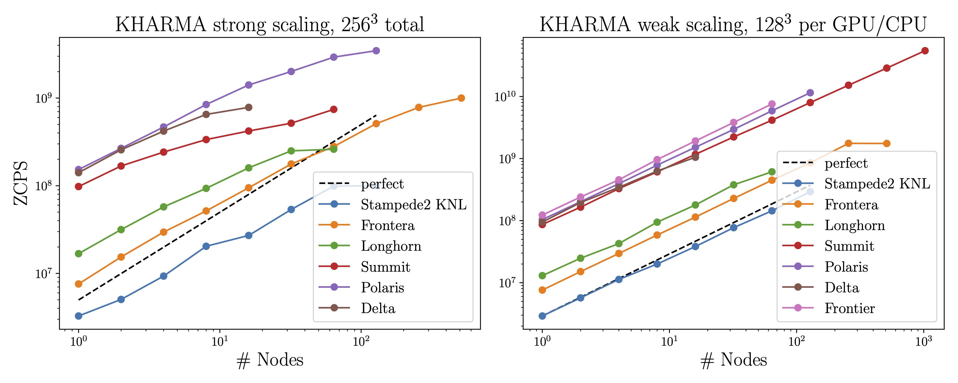
Performance

Slide 10
Updates: Mesh Refinement

Slide 11
Updates:
Inversion

Slide 12
Updates: Boundaries

Slide 13
Future Plans
MAD Taxonomy
  There are hints of many different kinds of MAD, depending on initial conditions
  We need to examine floor effects and biases in GRMHD, including w/h
Electron temperatures
  Heat and cool electrons self-consistently in GRMHD
  Now cooling with a simple optically thin limit
  Eventually, cool with RT
Radiative transfer:
  M1 closure
  Eventually MC-based and/or continuous solution of the full RT equations
With radiation and SMR, we can also push to thinner disks!
  Better understand sources that defy continuum fitting
  Better understand X-Ray hard state
  Super-Eddington…?

Slide 14
Conclusions
GRMHD, by way of simulation libraries, has been a unique holistic source of insight into EHT sources. It’s also a valuable “ground truth” for understanding system parameters and developing intuition and simple models
KHARMA is designed to generate next-generation GRMHD libraries and studies, by being fast yet simple and extensible, using a modern, open approach
This makes it uniquely suited to be a platform for diverse projects, with several different applications already in progress, and many future possibilities. Come join us!
  https://github.com/AFD-Illinois/kharma
Many thanks to the several other developers who have worked on KHARMA: Vedant Dhruv, Hyerin Cho, César Díaz Blanco, George Wong, and Angelo Ricarte

Slide 16
Physics Features
“Restart+” features: re-gridding to run at higher resolution, resizing or changing the domain, adding hotspots…
  Due to general elliptic solver for eliminating ∇·B
Co-evolved electron heating prescriptions
Per-zone semi-implicit solver available for arbitrary implicit source terms
  EMHD implementation largely finished
Isolated, swappable magnetic field transport
Static (internal and block-based) and adaptive mesh refinement

Slide 17
Backup Slides: Disks

Slide 18
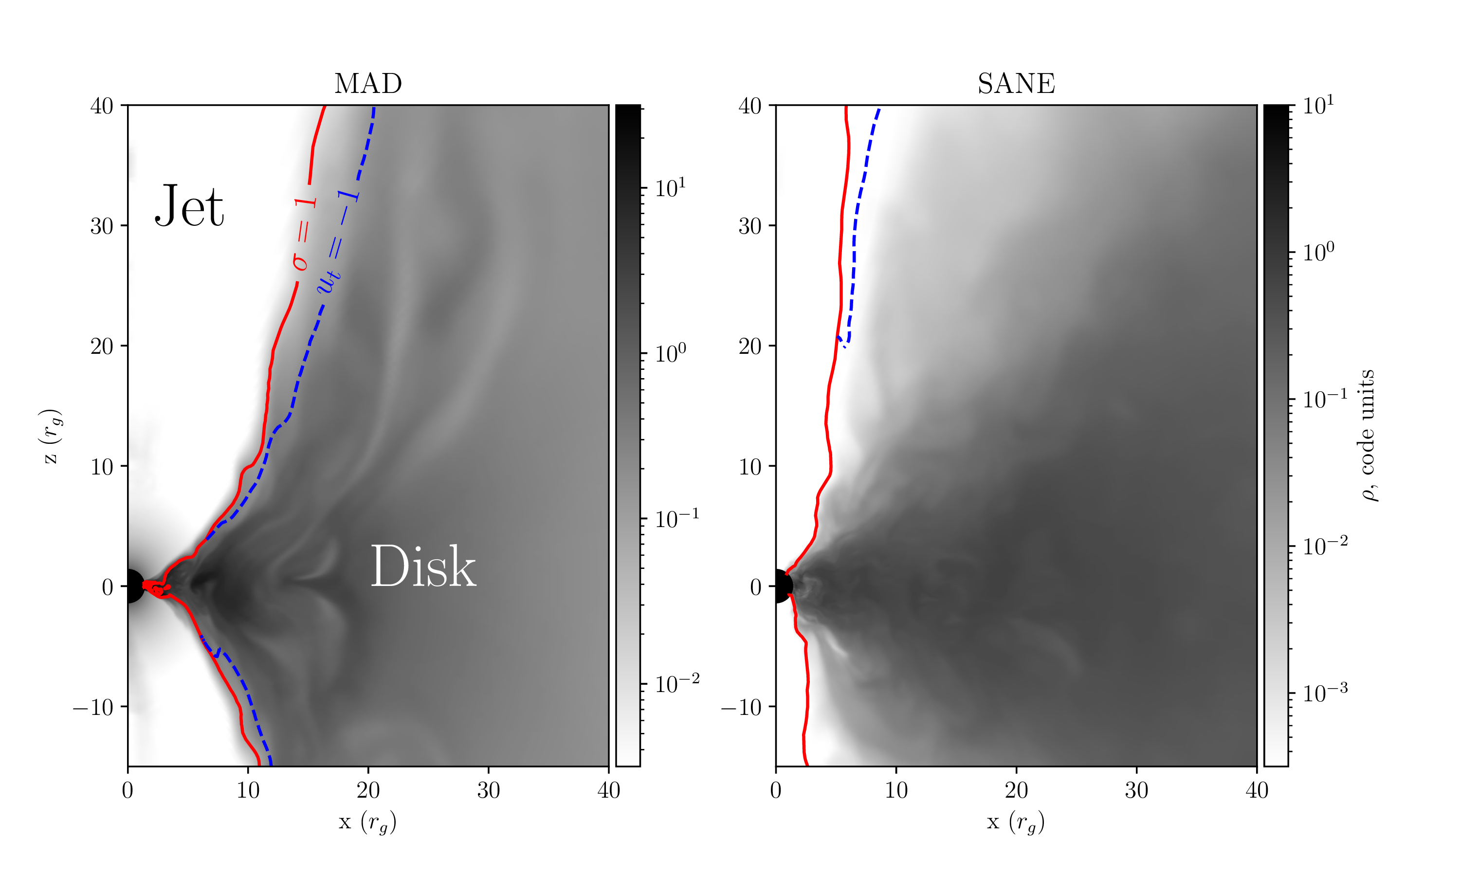
Jet Definitions

Slide 19
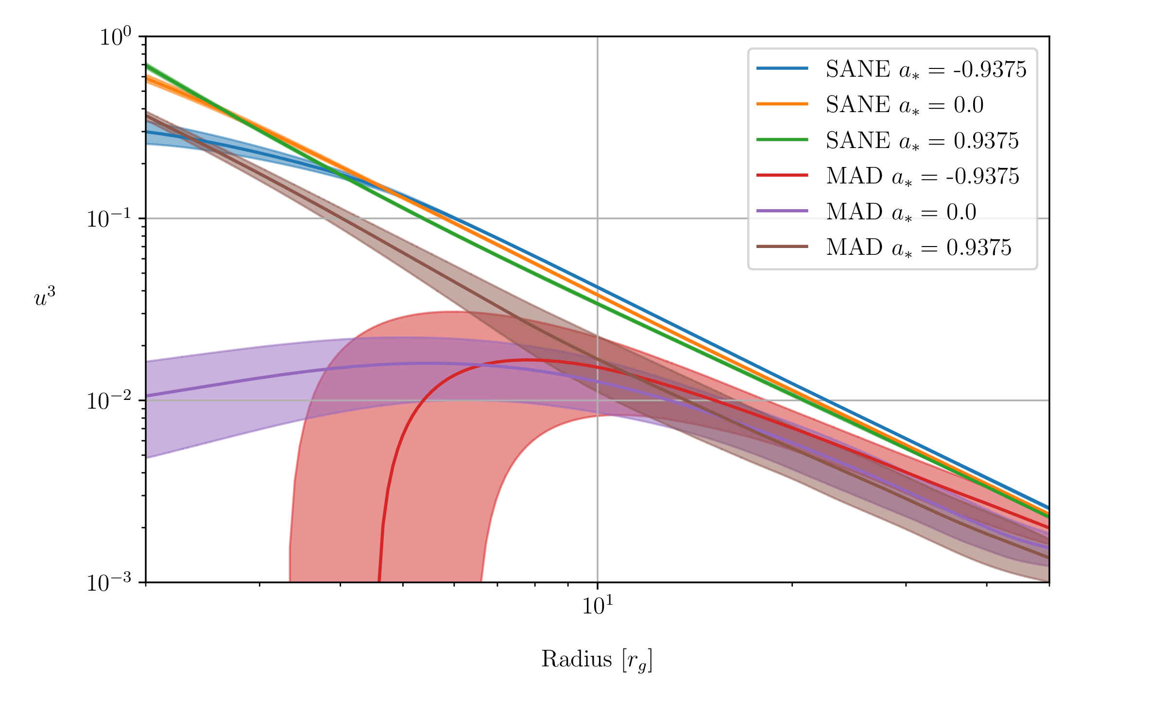
MADs & SANEs

Slide 20
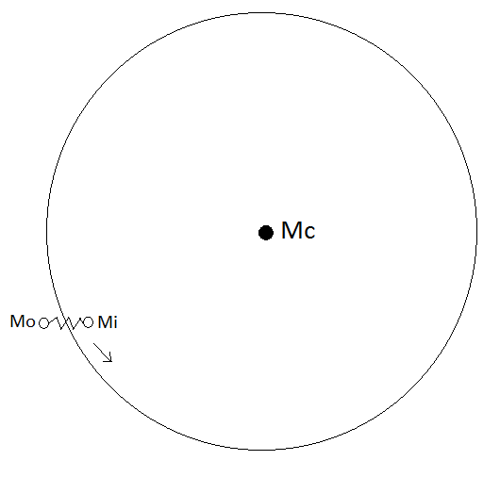
Magnetorotational Instability
Notes:
In this simple model of magnetorotational instability, two small masses, mi and mo, orbit a massive central object of mass Mc. The spring connecting the two masses tends to slow mi down, decreasing its angular momentum. Since an object's orbital radius decreases with decreasing angular momentum, mi moves even closer to the central object. The opposite occurs for mo: it gains angular momentum and moves even farther from the central object. Thus, a small difference in the positions of mi and mo tends to be magnified. In highly conductive plasmas, the magnetic field acts as the spring, giving rise to magnetorotational instability.

Slide 21
Backup Slides: GRMHD Simulations

Slide 22
iharm3D
HARM implementation in C taken from bhlight (Ryan et al. 2015)
MPI/OpenMP hybrid parallelization designed for simplicity
Loop/memory ordering designed for performance on Xeon Phi: hotspots use shorter, compiler-vectorized loops designed for continuous memory access
Suite of regression tests
  Also validated in a comparison of several codes (Porth et al. 2020)
Notes:
In anticipation of April 2019 results, took the GRMHD portion of a code called bhlight
Iharm3d’s re-ordering is largely loop-splitting:
KNLs have very high-bandwidth memory, like GPUs, so the penalty for not vectorizing is way worse than reading from RAM too often.

Slide 23
Backup Slides: KHARMA

Slide 24
KHARMA Features
First-order flux corrections limit floor hits
Transmitting polar boundaries with minimal
Coordinate-agnostic (Kerr, near-Kerr, whatever)
All options are run-time
Resizing Simulations
Multiple field transports
Implicit solver as a service

Slide 25
Performance Portability
Raspberry Pi 3: 40k ZCPS
Smartphone (Snapdragon 690): 300k ZCPS
XPS 13 (before thermal throttling): 1.95M ZCPS
XPS 13 (thermal throttled): 1.1M ZCPS
Notes:
2D torus sims on consumer hardware: potentially BOINC-able, or OSG.
Original quoted harm2d speed: 43k ZCPS
On equivalent hardware, KHARMA is about 2x faster than the most recent version of iharm2d

Slide 26
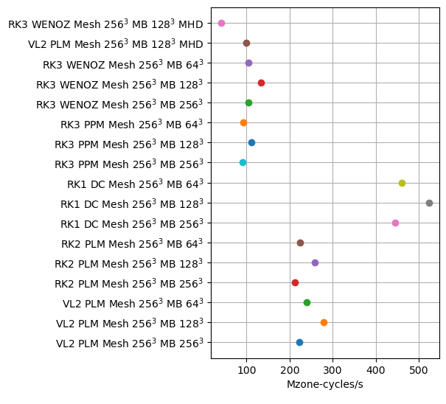
vs. AthenaPK Performance
20M/100M ~ 5x difference on V100
~5x for equivalents on CPUs, likely at least 2x improvement possible
Known single hotspot to defuse!

Slide 27
KHARMA: Alternatives
KHARMA: portable, mesh refinement, stationary
Phoebus: portable, mesh refinement*, arbitrary EOS + simple dynamical spacetime
iharm3D: KNL/CPU, no mesh refinement (~ebhlight, radiative)
KORAL: CPU, M1 radiative, GRFFE
Athena++: CPU, mesh refinement, radiative
AthenaK: portable, mesh-refinement, stationary+Cartesian
H-AMR: GPU, mesh refinement+LAT, M1 Radiative
BHAC: CPU, mesh refinement
IllinoisGRMHD: CPU, mesh refinement, dynamical
There are many other HARM derivatives, other dynamical codes, etc., etc.
Notes:
HARM-Noble
KORAL
HARMPI
^ All pretty HARM-like, different integrator choices
ECHO: high-order IMEX
Cosmos++: unstructured meshes
Apparently PLUTO is still a thing too?

Slide 28
Backup Slides: Libraries

Slide 29
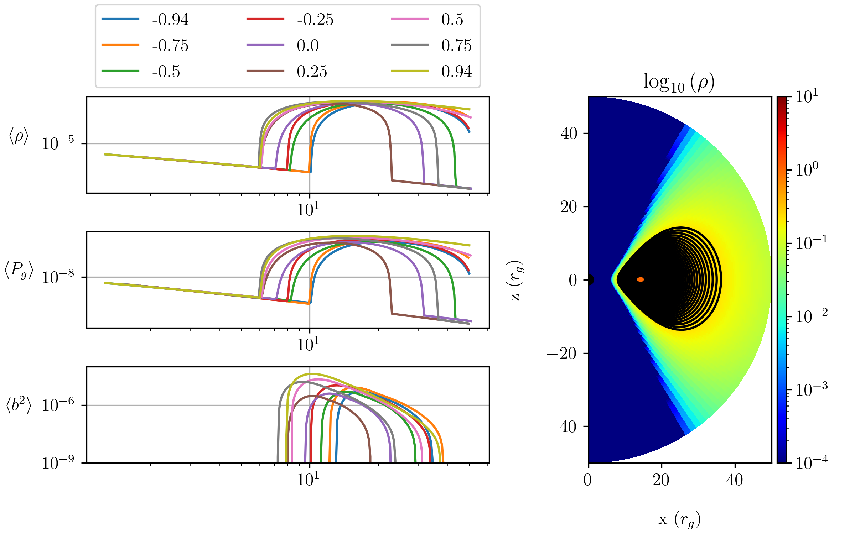
Initialization: v1

Slide 30
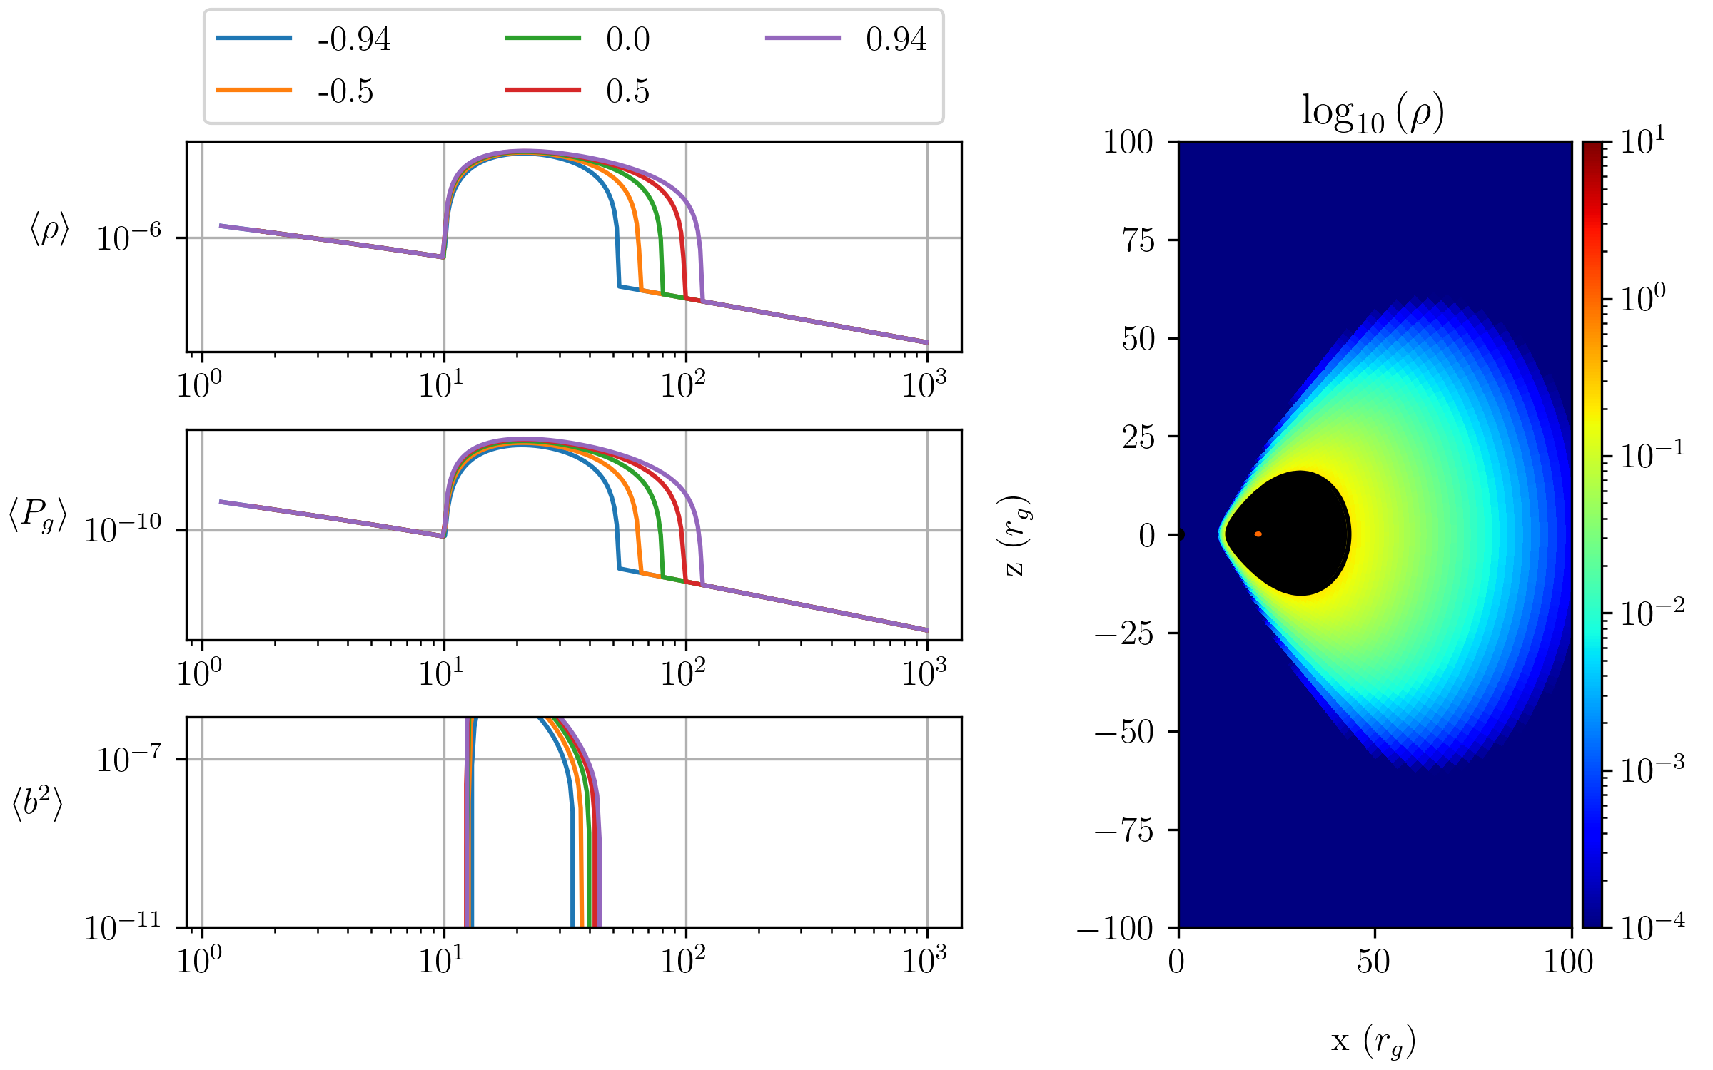
Initialization: v3

Slide 31
EHT Simulation Library “v5”
Base campaign: 104 moderate-resolution, long-duration GRMHD simulations:
  13 spins
  4 disk inclinations
  2 magnetic field fluxes (MAD/SANE)
  60kM duration each
Focused campaign: 26 high-resolution (doubled in each dimension) simulations of aligned disks
Hero run: 1 simulation of top candidate model, double the resolution of Focused campaign
Total: 131 simulations, 450,000 node-hours on Summit

Slide 32
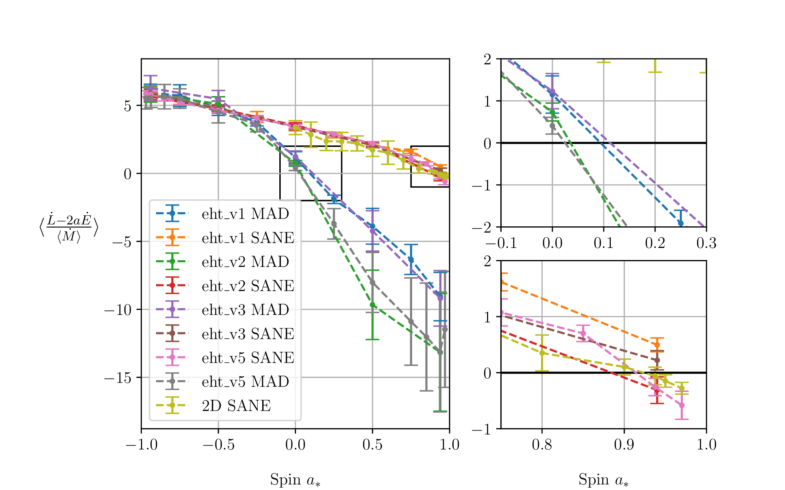
Spin-up

